Slide 1

Data
2
CS/COE 0449 Introduction to Systems Software
Representation
wilkie
(with content borrowed from Vinicius Petrucci and Jarrett Billingsley)
Spring 2019/2020

Slide 2
Binary Encoding
Bits, Bytes, and Nybbles

Slide 3
Positional Number Systems
The numbers we use are written positionally: the position of a digit within the number has a meaning.
Most Significant
Least Significant
1,234
=
1 × 10³ +
2 × 10² +
3 × 10¹ +
4 × 10⁰
1000s
100s
10s
1s
10³
10²
10¹
10⁰
How many digit symbols do we have in our number system?
10: 0, 1, 2, 3, 4, 5 ,6 ,7, 8, 9

Slide 4
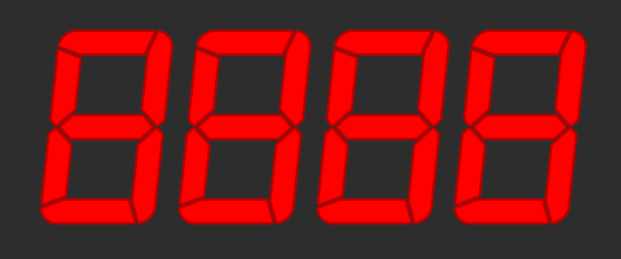
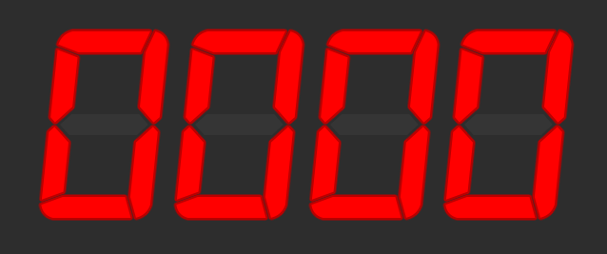
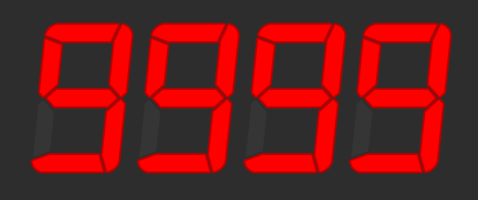
Ranges of Representation
Suppose we have a 4-digit numeric display.
What is the smallest number it can show?
What is the biggest number it can show?
How many different numbers can it show?
9999 - 0 + 1 = 10,000
What power of 10 is 10,000?
10⁴
With n digits:
We can represent 10^{n} numbers
The largest number is 10^{n}-1

Slide 5
Numeric Bases
These 10s keep popping up… and for good reason
We use a base-10 (decimal) numbering system
10 different digits, and each place is a power of 10
But we can use (almost) any number as a base!
The most common bases when dealing with computers are base-2 (binary) and base-16 (hexadecimal)
When dealing with multiple bases, you can write the base as a subscript to be explicit about it:
5₁₀ = 101₂

Slide 6
Let’s make a base-2 system
Given base B,
There are B digit symbols
Each place is worth B^{i}, starting with i = 0 on the right
Given n digits,
You can represent B^{n} numbers
The largest representable number is B^{n} – 1
So how about base-2?

Slide 7
Binary (base-2)
We call a Binary digIT a bit – a single 1 or 0
When we say an n-bit number, we mean one with n binary digits
MSB LSB
1 × 128 +
0 × 64 +
0 × 32 +
1 × 16 +
0 × 8 +
1 × 4 +
1 × 2 +
0 × 1
= 150₁₀
1001 0110
=
2⁷ 2⁶ 2⁵ 2⁴ 2³ 2² 2¹ 2⁰
128s 64s 32s 16s 8s 4s 2s 1s
To convert binary to decimal: ignore 0s, add up place values wherever you see a 1.

Slide 8
Bits, Bytes, Nybbles, and Words
A bit is one binary digit, and its unit is lowercase b.
A byte is an 8-bit value, and its unit is UPPERCASE B.
This is why your 30 megabit (Mb/s) internet connection can only give you at most 3.75 megabytes (MB) per second!
A nybble (awww!) is 4 bits – half of a byte.
Corresponds nicely to a single hex digit.
A word is the "most comfortable size" of number for a CPU.
When we say "32-bit CPU," we mean its word size is 32 bits.
This means it can, for example, add two 32-bit numbers at once.
BUT WATCH OUT:
Some things (Windows, x86) use word to mean 16 bits and double word (or dword) to mean 32 bits.

Slide 9
Why binary? Whynary?
Because it's the easiest thing to implement!
Basic arithmetic is a bit easier.
So, everything on a computer is represented in binary.
everything.
EVERYTHING.
01000101 01010110 01000101 01010010 01011001 01010100 01001000 01001001 01001110 01000111 00101110
(“EVERYTHING.”)

Slide 10
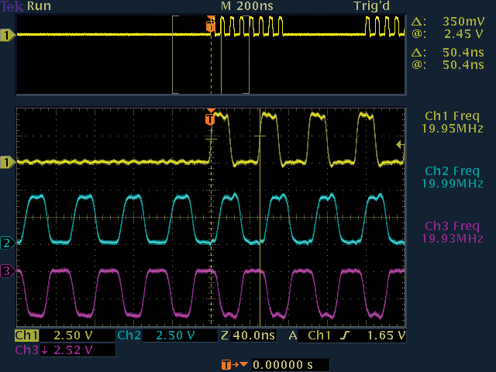
Binary Representation
Computers translate electrical signals to either 0 or 1.
It is relatively easy to devise electronics that operate this way.
In reality, there is no such thing as “binary” so we often have to approximate and mitigate error.
Oscilloscope visualization of several digital wires. From @computerfact on Twitter.

Slide 11
Integer Encoding
Casting is Not Just a Witch or Wizard Thing

Slide 12
Hexadecimal
Binary numbers can get really long, quickly.
3,927,664₁₀ = 11 1011 1110 1110 0111 0000₂
But nice "round" numbers in binary look arbitrary in decimal.
1000000000000000₂ = 32,768₁₀
This is because 10 is not a power of 2!
We could use base-4, base-8, base-16, base-32, etc.
Base-4 is not much terser than binary
e.g. 3,927,664₁₀ = 120 3331 2323 0000₄
Base-32 would require 32 digit symbols. Yeesh.
They do, oddly, have their place… but not really in this context.
Base-8 and base-16 look promising!
Decimal
Binary
Hex
0
0
0000
1
1
0001
2
2
0010
3
3
0011
4
4
0100
5
5
0101
6
6
0110
7
7
0111
8
8
1000
9
9
1001
A
10
1010
B
11
1011
C
12
1100
D
13
1101
E
14
1110
F
15
1111

Slide 13
Hexadecimal or “hex” (base-16)
Digit symbols after 9 are A-F, meaning 10-15 respectively.
Usually we call one hexadecimal digit a hex digit. No fancy name :(
0 × 16⁷ +
0 × 16⁶ +
3 × 16⁵ +
11 × 16⁴ +
14 × 16³ +
14 × 16² +
7 × 16¹ +
0 × 16⁰ =
3,927,664₁₀
003B EE70
=
16⁷ 16⁶ 16⁵ 16⁴ 16³ 16² 16¹ 16⁰
To convert hex to decimal: use a dang calculator lol

Slide 14
Binary to Hex (animated)
0100
1100
1010
0010
0000
0010
0110
0001
4
C
A
2
0
2
6
1
0x4CA20261
32-bits! (Not so bad…)
Q: Create a random binary string and practice!

Slide 15
Signed Numbers (sign-magnitude)
Seems like a good time to think about “negative” values.
These are numbers that have nothing good to say.
Binary numbers have bits which are either 0 or 1.
Well, yeah…
So what if we used one bit to designate “positive” or “negative”
Called sign-magnitude encoding:
10100010 =
-34
00010110 =
22 (normal)

Slide 16
Signed Numbers (problems)
10000000 =
-0
00000000 =
0
Waaaaait a second.
What is negative zero???
This encoding allows two different zeros.
This means we can represent how many different values (8-bit)?
2⁸ – 1 (minus the one redundant value) = 255 (-127 … 0 … 127)
Sign-magnitude is a little naïve… let’s try a different approach…

Slide 17
Signed Numbers (2’s Complement)
This one, I promise, is juuuuust right.
But it’s a little strange!
We’ll just make SURE there is only one zero:
So, we flip the bits… and add one.
Adding one makes sure our -0 is used for -1 instead!
Sure, it’s a little lopsided, but, hey, we get an extra number.
But, hmm, but -4 doesn’t have a valid positive number.
That’s the trade-off, but it’s for the best.
😘
100
110
000
010
100
110
000
010
111
101
001
011
101
111
001
011
-3
-2
-1
0
+1
+2
+3
-4
-3
-2
-1
0
+1
+2
+3
Signed Magnitude
2’s Complement

Slide 18
Signed Numbers (2’s Complement)
Let’s look some examples:
If the MSB is 1: Flip! Add one!
Otherwise: Do nothing! It’s the same!
11010100=
-00101011=-(43+1)=-44
00100110=
00100110= 38
00000000=
00000000= 0
11111111=
-00000000=-(0+1) =-1

Slide 19
Signed Numbers (2’s Complement)
What happens when we add zeros to a positive number:
What happens when we add ones to a negative number:
00100110 = 38
10100110 = ?
38
0000000000100110 = ?
-(01011001+1) = ?
-01011010 = ?
-90
10100110 = ?
-90
Dang that’s cool!
11111111110100110 =
-00000000001011001 = ?
-90

Slide 20
Can I Get an Extension?
Sometimes you need to widen a number with fewer bits to more
zero extension is easy: put 0s at the beginning.
1001₂ ➔ to 8 bits ➔ 0000 1001₂
But there are also signed numbers… what about those?
The top bit (MSB) of signed numbers determines the sign (+/-)
sign extension puts copies of the sign bit at the beginning
1001₂ ➔ to 8 bits ➔ 1111 1001₂
0010₂ ➔ to 8 bits ➔ 0000 0010₂
Q: What happens when you sign extend the largest unsigned value?

Slide 21

Absolutely Bonkers
public class AbsTest {
public static int abs(int x) {
if (x < 0) {
x = -x;
}
return x;
}
public static void main(String[] args) {
System.out.println(
String.format("|%d| = %d", Integer.MIN_VALUE, AbsTest.abs(Integer.MIN_VALUE))
);
}
} // Outputs: |-2147483648| = -2147483648
Q: How many bits is a Java int? What happened here?

Slide 22
Integer Ranges
Recall:
The range of an unsigned integer is 0 to 2^{n} – 1
Q: Why do we subtract 1?
What is the range of a 2’s complement number?
Consider the sign bit, how many negative integers?
Consider, now, the positive integers.
Remember 0.
-2^{n-1} to 2^{n-1} – 1
Q: What if you needed a range with far more negatives than positives?

Slide 23
Integers in C
C allows for variables to be declared as either signed or unsigned.
Remember: “signed” does not mean “negative” just that it can be negative.
An unsigned integer variable has a range from 0 to 2^{n} – 1
And signed integers are usually 2’s complement: 2^{n-1} to 2^{n-1} – 1
Where “n” is determined by the variable’s size in bits.
Integer Types: (signed by default, their sizes are arbitrary!!)
char unsigned char 8 bits (byte)
short int unsigned short int 16 bits (half-word)
int unsigned int 32 bits (word)
long int unsigned long int 64 bits (double-word)
Usually no strong reason to use anything other than (un)signed int.
Q: What is the range of a signed char?

Slide 24
Integers in C: Limits
Since sizes of integers are technically arbitrary…
They are usually based on the underlying architecture.
… C provides standard library constants defining the ranges.
https://pubs.opengroup.org/onlinepubs/009695399/basedefs/limits.h.html
#include <limits.h> // Provides INT_MAX etc
#include <stdio.h> // Provides printf
int main() {
printf("%d ", INT_MAX); // Print the maximum signed int
printf("%u\n", UINT_MAX); // Print the maximum unsigned int
return 0;
} // Output: 2147483647 4294967295
Q: Experiment with using "%d" for both. What is the result?

Slide 25
Casting
C lets you move a value from an unsigned integer variable to a signed integer variable. (and vice versa)
However, this is not always valid! Yet, it will do it anyway.
The binary value is the same, its interpretation is not!
This is called coercion, and this is a relatively simple case of it.
Since it ignores obvious invalid operations this is sometimes referred to as “weak” typing.
The strong/weak terminology has had very fragile definitions over the years and are arguably useless in our context. Let’s ignore them.
Moving values between different types is called casting
Which sounds magical and it sometimes is.
Q: What is true of the result of casting the value -1 to an unsigned type?

